Slide 1

AWS CloudFormation
Ayanda Tshabalala
Associate Cloud Transformation Consultant

Slide 2


AWS CloudFormation
What is AWS CloudFormation
Why would it be useful during a hackathon
Workshop Guide
Key takeaways
Speeds up cloud provisioning with infrastructure as code
Template
Stack

Slide 3



What is AWS CloudFormation?
You
AWS CloudFormation
Notes:
Puzzle designer ( designs a pieces ( AWS resources) of the puzzles that makes sense and that can be solved ) - You create a code file (template that follows the rules) that describes those AWS resources you are going to need
Puzzle solver (the thinking, rotating) to get the whole picture where each piece is connected to one another to create a result(stack in CloudFormation) – You create a template that describes all the AWS resources that you want (like Amazon EC2 instances or Amazon RDS DB instances), and CloudFormation takes care of provisioning and configuring those resources for you

Slide 4
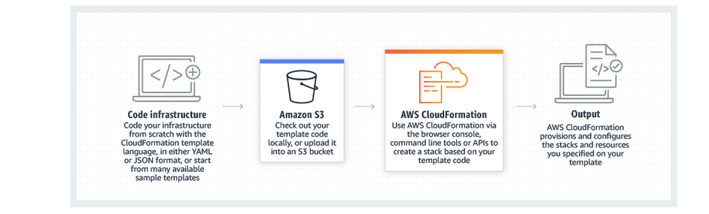
Why would it be useful during a hackathon
Notes:
AWS CloudFormation lets you model, provision, and manage AWS resources by treating infrastructure as code.

Slide 5
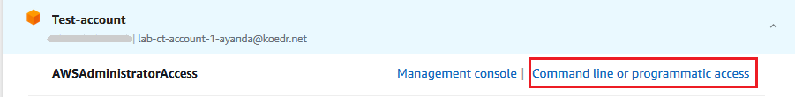
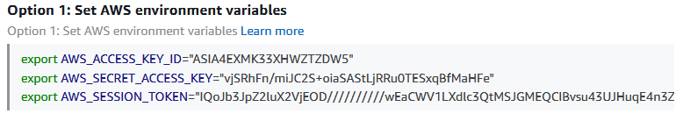
Workshop Guide
Prerequisites
Install and configure the AWS CLI
Configure your credentials

Slide 6
Workshop Guide
Advance
Modules
Under Dynamic References for Parameter Store section number 3, use the following as your ImageId property instead of the one provided.
ImageId: '{{resolve:ssm:/golden-images/amazon-linux-2}}'
https://catalog.workshops.aws/cfn101/en-US

Slide 7
Key takeaways
You created 5 resources
Amazon S3 Bucket
Bucket Policy
Logging Bucket
CloudFront Origin Identity
CloudFront Distribution
2. Where to get syntax https://docs.aws.amazon.com/AWSCloudFormation/latest/UserGuide/aws-properties-s3-bucket.html
3. You have automated the provision of these 5 resources

